Slide 1
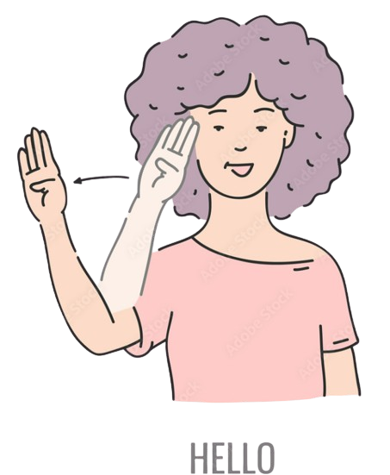

Slide 2

Silent-Talk:
Bridging Communication for Deaf and Blind
Team Member :
Project Mentor:
Vraj Patel (21BECE30244)
Harsh Patel (21BECE30191)
Vishva Patel (21BECE30242)
Charmi Rupareliya (21BECE30278)
Dr. Hitesh Patel
Department of Computer Engineering

Slide 3
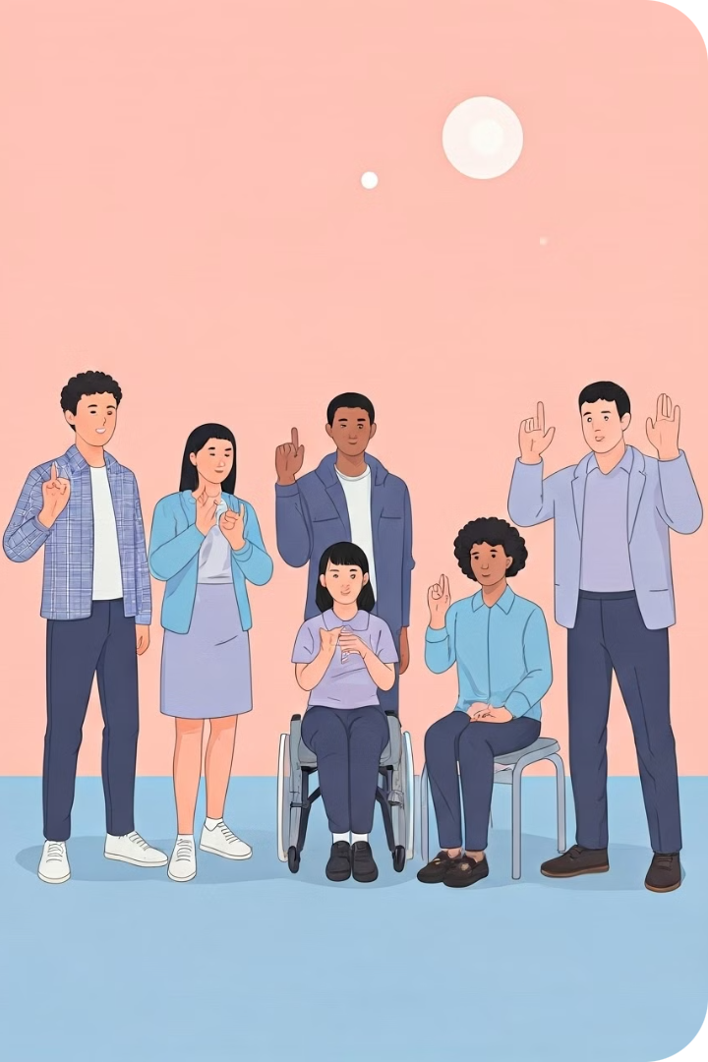
Introduction
Silent-Talk is a pioneering AI/ML-based platform meticulously designed to bridge the communication gap between deaf and blind individuals. By leveraging advanced technologies in artificial intelligence and machine learning, this innovative system aims to facilitate seamless interactions and foster mutual understanding. Silent-Talk is not just a technological advancement; it's a step towards dismantling communication barriers and promoting inclusivity on a global scale. Through its groundbreaking approach, Silent-Talk aspires to create a world where everyone can connect and communicate effortlessly, regardless of sensory limitations.
Notes:
null

Slide 4

Problem Approach
1
Communication Challenges
Deaf individuals rely on visual cues, while blind people depend on audio or tactile feedback. This creates a significant barrier between the two groups.
2
Current Limitations
Existing solutions often fail to address the unique needs of both deaf and blind individuals simultaneously, leaving a gap in effective communication.
3
Our Solution
Silent-Talk leverages AI/ML to translate sign language into audio and Braille, creating a bridge between deaf and blind communities.
Notes:
null

Slide 5

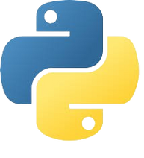

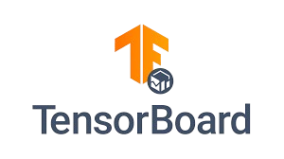
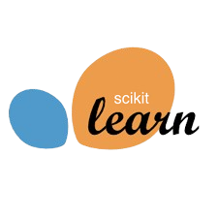



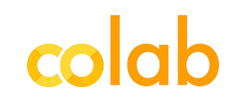
Tools & Technologies
Programming
Frameworks
Tools
Evaluation
Notes:
null

Slide 6
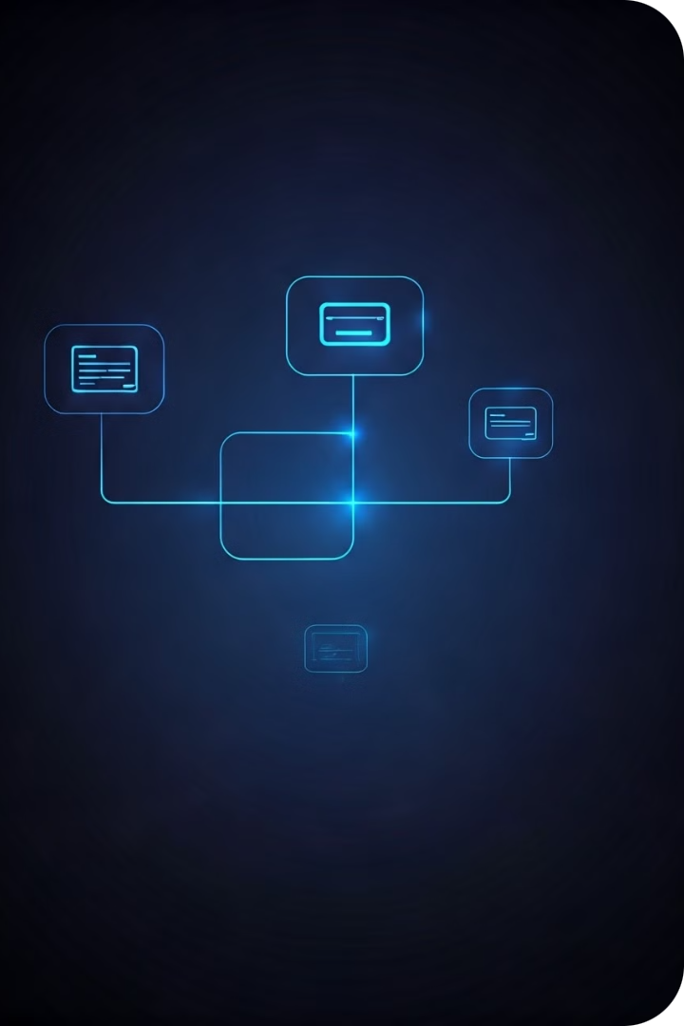
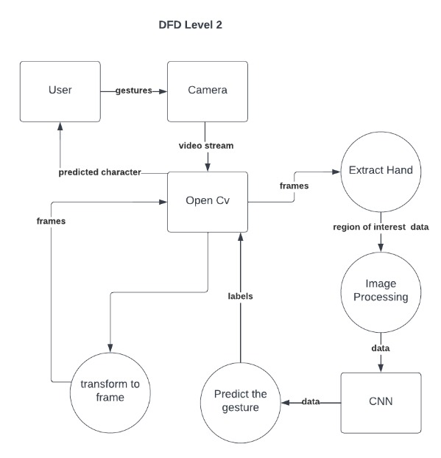
Data Flow Architecture
Notes:
null

Slide 7
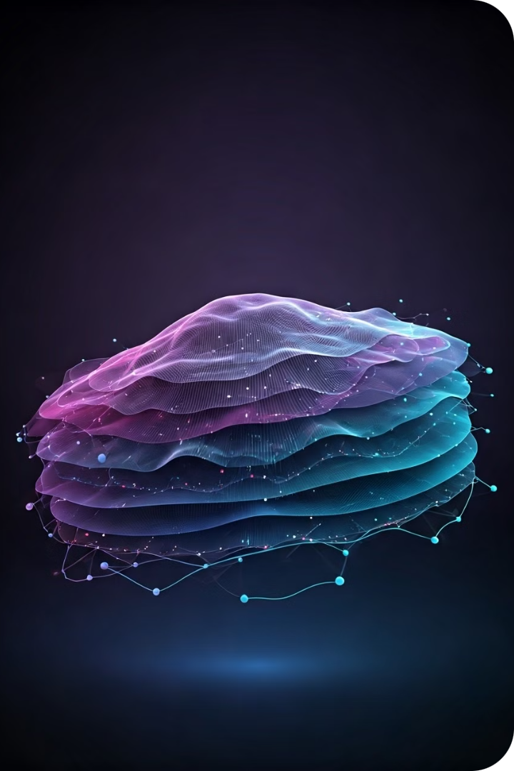
Model Architecture and Dataset Comparison
Dataset
Model
Accuracy
Remarks
ASL [3]
CNN
0.99
Overfitting
ISL [1]
CNN
0.99
Overfitting
ISL [1]
LSTM
0.99
Overfitting
WLASL [2]
LSTM
0.72
Good Accuracy
WLASL [2]
CNN
0.65
Moderate Accuracy
ASL [3]
LSTM
0.89
Best Fit
Notes:
null

Slide 8
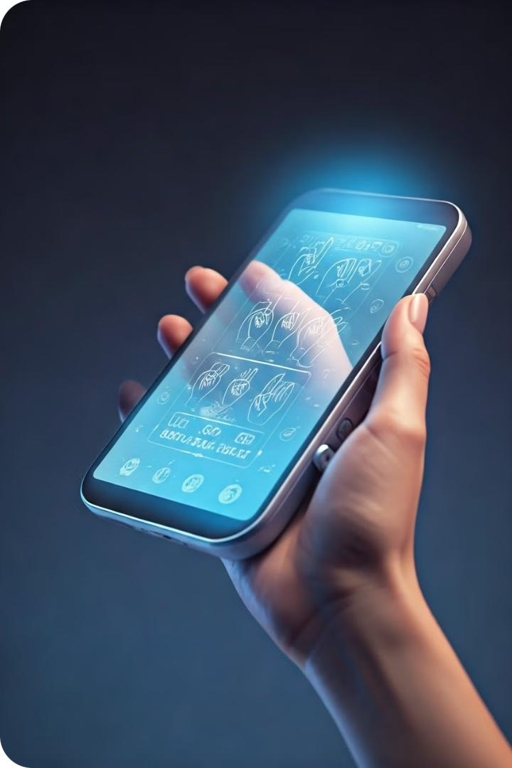




Key Features
Real-time Translation
Instant conversion of sign language to audio and Braille for seamless communication.
Customization
Personalized settings to cater to individual user needs and preferences.
Portability
Compact, user-friendly design for easy use in various settings and situations.
Scalability
Adaptable for use in education, workplaces, and public services.
Notes:
null

Slide 9
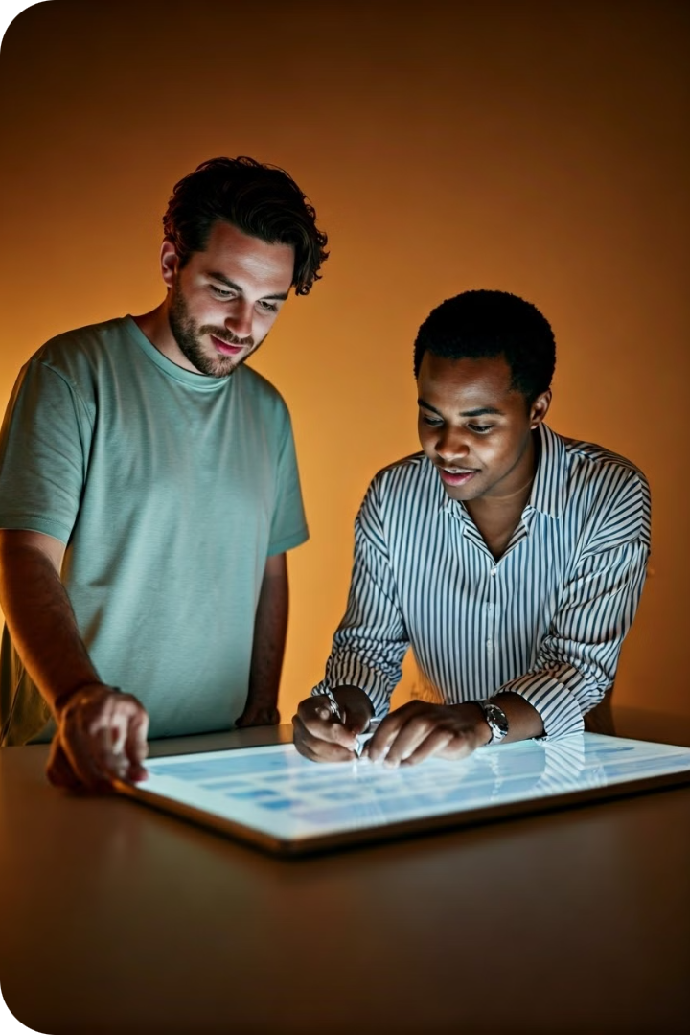
Project Goals
1
Primary Goals
Develop a robust AI/ML communication system with high accuracy and user-friendliness.
2
Secondary Goals
Curate diverse datasets, continuously improve models, and collaborate with organizations for wider adoption.
3
Long-term Vision
Create a more inclusive society by breaking down communication barriers between deaf and blind individuals.
Notes:
null

Slide 10
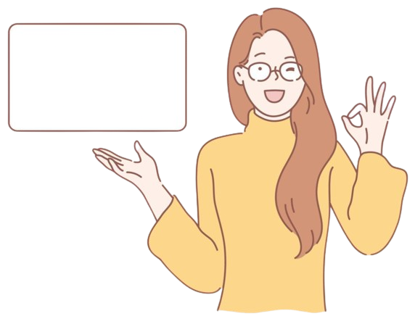
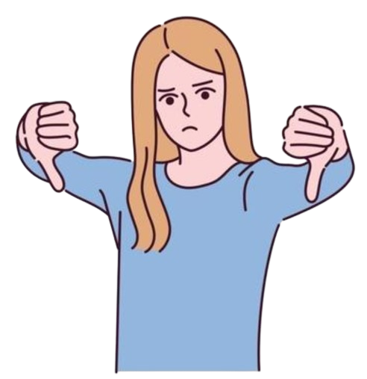
Enhances communication between deaf and blind individuals
Challenges in obtaining high-quality, representative datasets
Promotes independence and social inclusion
Potential resistance to new technology adoption
Utilizes cutting-edge AI/ML techniques
Real-time processing and accuracy issues
Notes:
null

Slide 11
Module / Work
Category | Task | Description
Implemented Work Phase - 1 | Database Collection | Compiled a comprehensive dataset for training and testing. Ensured data diversity and quality.
 | Model Training | Utilized collected data to train initial models. Conducted multiple training sessions to refine model accuracy.
 | Model Evaluation | Tested various machine learning models. Evaluated performance metrics to identify the most effective model.
 | Recognition of A-Z Hand Signs | Achieved accurate recognition of all alphabet hand signs. Validated results through rigorous testing.
Implemented Work Phase - 2 | Expansion of Sign Prediction | Integrate more complex and additional signs into the system. Ensure high accuracy and reliability for new signs.
 | User Interface Development | Design and develop a user-friendly interface. Ensure accessibility for both deaf and blind users.
 | Text-to-Speech Integration | Implement text-to-speech functionality. Ensure clear and accurate vocalization of recognized signs.

Slide 12
Future Work
[1] Enhancing Model Generalization
[2] Expanding Dataset Diversity
[3] Integrating Multimodal Feedback Mechanism
[4] User Adaptability and Learning Capabilities
[5] Cloud Deployment

Slide 13
References
[1] https://www.kaggle.com/datasets/prathumarikeri/indian-sign-language-isl
[2] https://www.kaggle.com/datasets/risangbaskoro/wlasl-processed
[3] https://www.kaggle.com/datasets/ayuraj/asl-dataset
[4] https://paperswithcode.com/dataset/ms-asl (RESEARCH PAPER)
[5] https://paperswithcode.com/dataset/wlasl (RESEARCH PAPER)
[6] https://ieeexplore.ieee.org/document/10116636 (Research Paper)

Slide 14
Bibliography
[1] https://www.youtube.com/watch?v=a99p_fAr6e4&list=PL0FM467k5KSyt5o3ro2fyQGt-6zRkHXRv
[2] https://www.youtube.com/watch?v=wa2ARoUUdU8&list=PL0FM467k5KSyt5o3ro2fyQGt-6zRkHXRv&index=2
[3] https://www.youtube.com/watch?v=pDXdlXlaCco&list=PL0FM467k5KSyt5o3ro2fyQGt-6zRkHXRv&index=4

Slide 15
